Slide 1
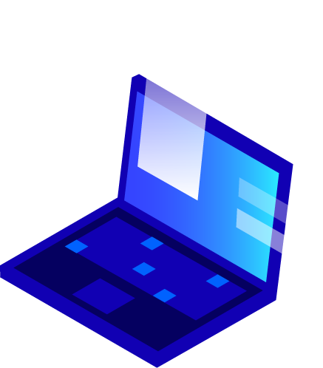
Optimizing Banks’ Approach to Cybersecurity

Slide 2
Global Thought Leader in Cybersecurity and Emerging Threats
President
Brooks Consulting International

Slide 3
Internet and Security
The Internet was not built for security, yet we have made it the backbone of virtually all private-sector and government operations, as well as communications. Pervasive connectivity has brought dramatic gains in productivity and pleasure but has created equally dramatic vulnerabilities. Huge heists of personal information are common, and cyber-theft of intellectual property and infrastructure penetrations continue at a frightening pace.
-Joel Brenner, former Counsel to the National Security Agency

Slide 4
1.
GLOBAL CYBERSECURITY TRENDS

Slide 5
Worldwide spending on cybersecurity is forecasted to reach $133.7 billion in 2022. (Gartner).
Security investments continue to be driven by persistent threats, policy remedies, workforce shortages, and technological innovation inside and outside security areas.
Threat actors, especially state-sponsored, and criminal enterprises will take advantage of the expanding cyber-attack surface by using their resources to employ more sophisticated means for discovering target vulnerabilities, automating their phishing attacks, and finding new deceptive paths for infiltrating malware
Disruptive technologies like mobility, IoT, and cloud computing bring operational shifts that drive new security requirements. Advances in security like continuous monitoring and analytics find strong reception with agencies.
.

Slide 6
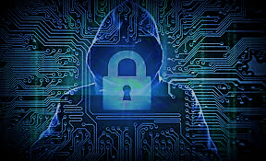
2. Cyber-Threat Realties

Slide 7
Cybercrime will cost the world $6 trillion annually by 2021
71% of all data breaches are financially motivated.
The cost of cyberattacks in the banking industry reached $18.3 million annually per company
There are over 430 million types of malware online and a cyber attack happens every 39 seconds
Risk Based Security reports that 7,098 breaches resulted in the exposure of more than 15.1 billion records in 2019.
The Carbank gang committed the largest robbery of the century, using malware to steal $1 billion from 100 different banks in 30 different countries.
The biggest data breach theft in history was carried out using spear phishing emails. The attack by the Carbank gang lasted for more than two years. It was unprecedented in that it didn’t target individual users, but instead robbed the banks directly

Slide 8
3. Banking Cyber- Trends/Threat Realties

Slide 9
Cyberattacks on financial firms have become a flourishing money-making business for cybercriminals. Cyberattacks against banks spiked by a massive 238% from the beginning of February to the end of April 2020
Cybersecurity: Building trust in digital channels and transactions is paramount, while with every new channel comes a new set of vulnerabilities. Complexities and sophistication of cyberattacks such as malware, spoofing, phishing and DDoS attack are growing by the day.
A qualified cybersecurity worker shortage continues to pose major challenges for industry.
Banking in the Cloud: the percentage of banks that have deployed cloud computing increased to 40% at the end of 2020.
Timeline chronicles ~200 cyber incidents targeting financial institutions since 2007, and can be filtered by country, region, year, attribution, incident type, and actor type: Timeline of Cyber Incidents Involving Financial Institutions - Carnegie Endowment for International Peace

Slide 10
4. CISO Banking Cybersecurity Challenges
Chief
Information
CISO
Security
Officer

Slide 11
Siloed organizations
Lack of contextual awareness of threats and solutions.
Reliance on bolted-on point products.
Tools that can be immediately implemented to support longer-term remote and distributed work
Scalability of Testing tools that deliver enormous data, all of which needs to be correlated and prioritized. Tasks take time, and CISOs are often dealing with more data than they have people to analyze it.
Privacy and data protection regulations are necessary, but can also create fragmented, and sometimes conflicting, priorities and costs for companies that can weaken defense mechanisms.
Malware developers and financial fraud [criminals] rely less on dark net marketplaces for distributing their exploits and instead levy black hat forums across the deep web and darknet to establish their brand, develop clout across the community, and recruit new members.

Slide 12
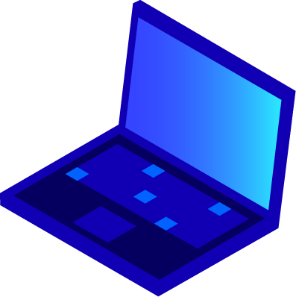
5. Technical Banking Cybersecurity Challenges

Slide 13
Phishing attacks: In 2020, COVID-19 phishing scams became the top cyberthreat of the year as such scams surged up by 112%.
Ransomware is the fastest-growing cybercrime and the COVID-19 pandemic has exacerbated this threat.
Zero-day attacks are becoming more and more sophisticated; a report concluded that incidents are expected to double in 2020.
Advanced persistent threats: Trojans can be placed at this point, wherein an attacker gains control of the computer system, creating a backdoor and obtaining access to confidential and sensitive data.
Distributed denial of service (DDoS) attacks flooding the network with unnecessary requests to overload the system and stop the achievement of genuine requests.
Updating Unpatched software that has a known security vulnerability and has been fixed.
Privacy and data protection can also create fragmented, and sometimes conflicting, priorities and costs for companies that can weaken defense mechanisms.

Slide 14
6. Cybersecurity Framework: Summary
Recover
Identify
Cyber Security
Protect
Respond
Detect

Slide 15
Risk Management (identifying, assessing and responding to threats- i.e. NIST Framework: Identify, Protect, Detect, Respond, Recover
Protecting critical infrastructure through rapid proto-typing of technologies and Public/Private cooperation
Modernizing security architectures
Mobile and BYOD Security
Incident Response
Policy: Best Practices, Compliance
SECURITY BY DESIGN, DEFENSE IN DEPTH, ZERO TRUST
Digital fraud management strategies are evolving. Banks today opt for a multilayered approach in cybersecurity. Multifactor authentication layered with risk-based access, behavioral biometrics and AI-driven anomaly detection, followed by end-to-end encryption.

Slide 16
7. Components of a Banking Cybersecurity Framework
Identify
Basic steps to minimize risk
Control
Analyze
Risk
Management
Monitor
Action

Slide 17
Analyze risk: Banking Institutions have the assets that the hackers seek. Analyzing the risk to these assets based on the impact or criticality is a way to go for an organization. The process should occur on a regular basis to identify any new potential threats.
Identify and classify the assets: financial institutions need to identify and categorize the information assets, based on levels of sensitivity, value, and criticality to the bank. Information assets including various categories of data that are highly-restricted, confidential, internal use, and the public.
Risk Assessment: It is advisable for every bank to prepare a Cyber security Risk Assessment and implement a cybersecurity protection plans to address those threats identified in the risk assessment procedure.

Slide 18
Confirm the Security Protocols of All Parties in Your Data Chain: it’s essential to perform security due diligence on all participants in your data chain: your partners, your vendors, and your vendors’ vendors - essentially any party that will be taking confidential information out of your firewall.
Vulnerability Assessment: Threat and vulnerability can be subjected to a person, an organization, weaknesses in the system or the network. Penetration testing is a means to identify these threats and vulnerabilities and to patch the weaknesses.
Employee Cyber Awareness- All employees should be aware of the threats and consequences of ignoring it. For instance, they should be aware of the hazard by clicking a malicious link or opening an attachment from an unknown person. Cybersecurity awareness training is critical since most cyber incidents are the result of “human error.”

Slide 19
8. Cybersecurity Tools & Protections
More than 60% of banks plan to increase 2021 cybersecurity spend
Cybersecurity Hygiene
Multi-factor authentication
Advanced Firewalls
Intrusion Prevention
Anti-Virus/Anti-Malware
Anti-Spam
Encryption
Web Application Controls
Patching
Data Loss Prevention.
Vulnerability Scanning
Security Information Management
File Integrity Monitoring
Air-gap compatible solutions which can keep infrastructure isolated and protected from the open environment
Red Team/Blue Team
Employee Awareness Training
Incident Response

Slide 20
9. Cybersecurity Tech Compliance Trends
Compliance and digital privacy policy requirements will continue to broaden across Banking & Financial industry sectors

Slide 21
Tech & Compliance:
Banks and financial services organizations have accelerated their adoption of biometrics, facial recognition and artificial intelligence (AI) to enable the use of digital identities and continue operations during the pandemic. The use of these technologies are likely to be subject to regulatory initiatives under the Biden Administration
Moving forward, expect banks and financial institutions to balance the usability of their platforms with security tools for identity verification and authentication, leveraging biometrics along with AI and ML to combat the rising wave of fraud targeting digital channels.

Slide 22
Notice of Breaches:
On December 18, 2020, the US Department of the Treasury (Office of the Comptroller of the Currency), Federal Reserve and Federal Deposit Insurance Corporation (FDIC) jointly announced a 53-page proposed rule that would require banks to notify their regulators within 36 hours of a “computer-security incident”. The proposed rule would also affect companies that provide certain services to those banks, including data processing. Those service providers would be required to notify “at least two individuals at affected banking organization customers immediately after the bank service provider experiences a computer-security incident that it believes in good faith could disrupt, degrade, or impair services provided for four or more hours.”
Source: US banking regulators propose a rule for 36-hour notice of breach | Data Protection Report

Slide 23
GDPR:
The GDPR entered into force on 25 May 2018. Prior to its entry into force, banks established extensive GDPR compliance projects in order to assess their personal data processing activities, map personal data flows both within and outside their organizations and ensure compliance with the new requirements.
Cybersecurity is particularly important to the banking sector. The Law of 5 April 1993 on the financial sector, as amended contains a general requirement for credit institutions to have in place effective control and security arrangements for information processing systems, as well as sound security mechanisms designed to guarantee the security and authentication of the means of transfer of information, to minimize the risk of data corruption and of unauthorized access and to prevent information leakage in order to maintain the confidentiality of data at all times.
Source: Data Security and Cybersecurity - Banking Regulation - Finance and Banking - Luxembourg (mondaq.com)

Slide 24
10. Emerging Technologies and Banking
The advent of emerging and fused technologies 5G, IoT (and Industrial IoT) will pose significant operational and regulatory challenges to banking.
Companies and institutions will look to automation and orchestration technologies such as machine learning, deep learning, artificial intelligence, and other analytic tools to mitigate gaps on ubiquitous platforms

Slide 25
Technologies of The 4th Industrial Revolution
Automation and Adaptive Networks
Artificial intelligence (human/computer interface)
Machine Learning
Cryptography/Encryption (Identity based encryption)
Blockchain
Simulation Virtualization & Gaming
Cloud computing and Edge Computing
Biometrics and Authentication Technologies
Software (anti-virus)
Hardware Separation/Hardening
Photonics/sensors
Big Data: Real-time analytics and predictive analytics
Super-computing and Quantum-computing

Slide 26
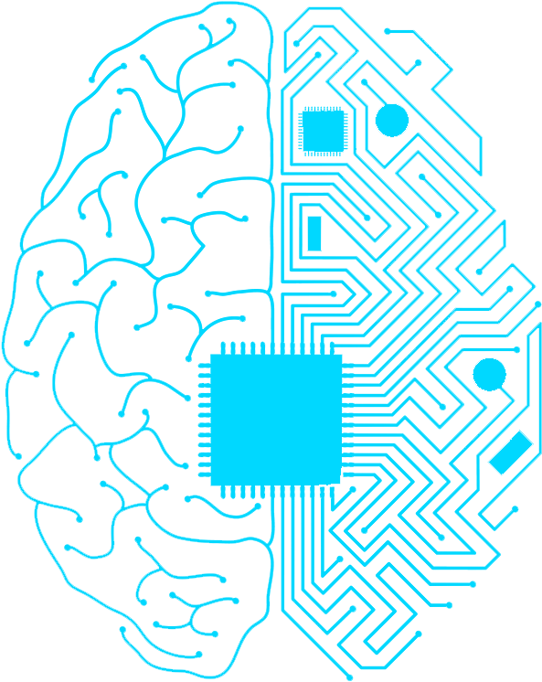
AI/ML AND CYBERSECURITY
Threat Detection (Spam and Phishing)
Malware Identification
Autonomous Patching
Categorize Attacks
Adapt To Evolving Risks
Both Offensive and Defensive Cyber
Cyber attackers use of offensive AI is becoming more sophisticated with the capability to self-mutate as it learns from its environment while hiding in the background by leveraging existing data flows and human behavior to remain undetectable amid the noise across networks
AI

Slide 28
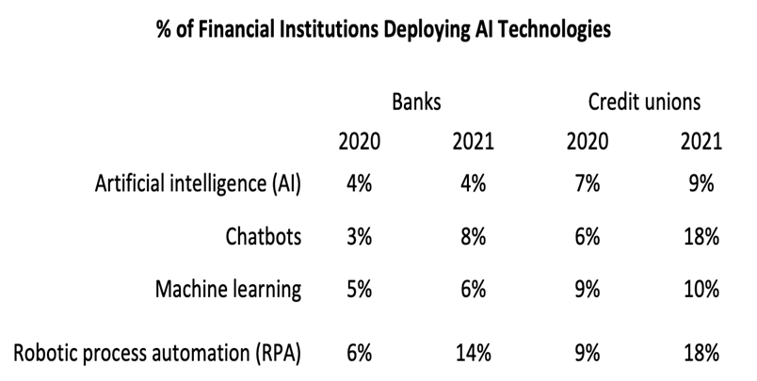
Artificial Intelligence Machine Learning

Slide 29
CLOUD COMPUTING
Cloud Computing consists of moving and storing data and applications over the Internet from remote servers.
Generally it offers users cost flexibility, mobility, and increased productivity. For cybersecurity it allows for firewalling and managed security.
An advantage of the cloud is you know where the data resides and who is managing its security.

Slide 30
BLOCKCHAIN
Blockchains are immutable digital ledger systems implemented in a distributed fashion (i.e., without a central repository) and usually without a central authority.
At its most basic level, they enable a community of users to record. transactions in a ledger public to that community such that no transaction can be changed once published.”
Blockchains are immutable digital ledger systems implemented in a distributed fashion (i.e., without a central repository) and usually without a central authority.

Slide 31
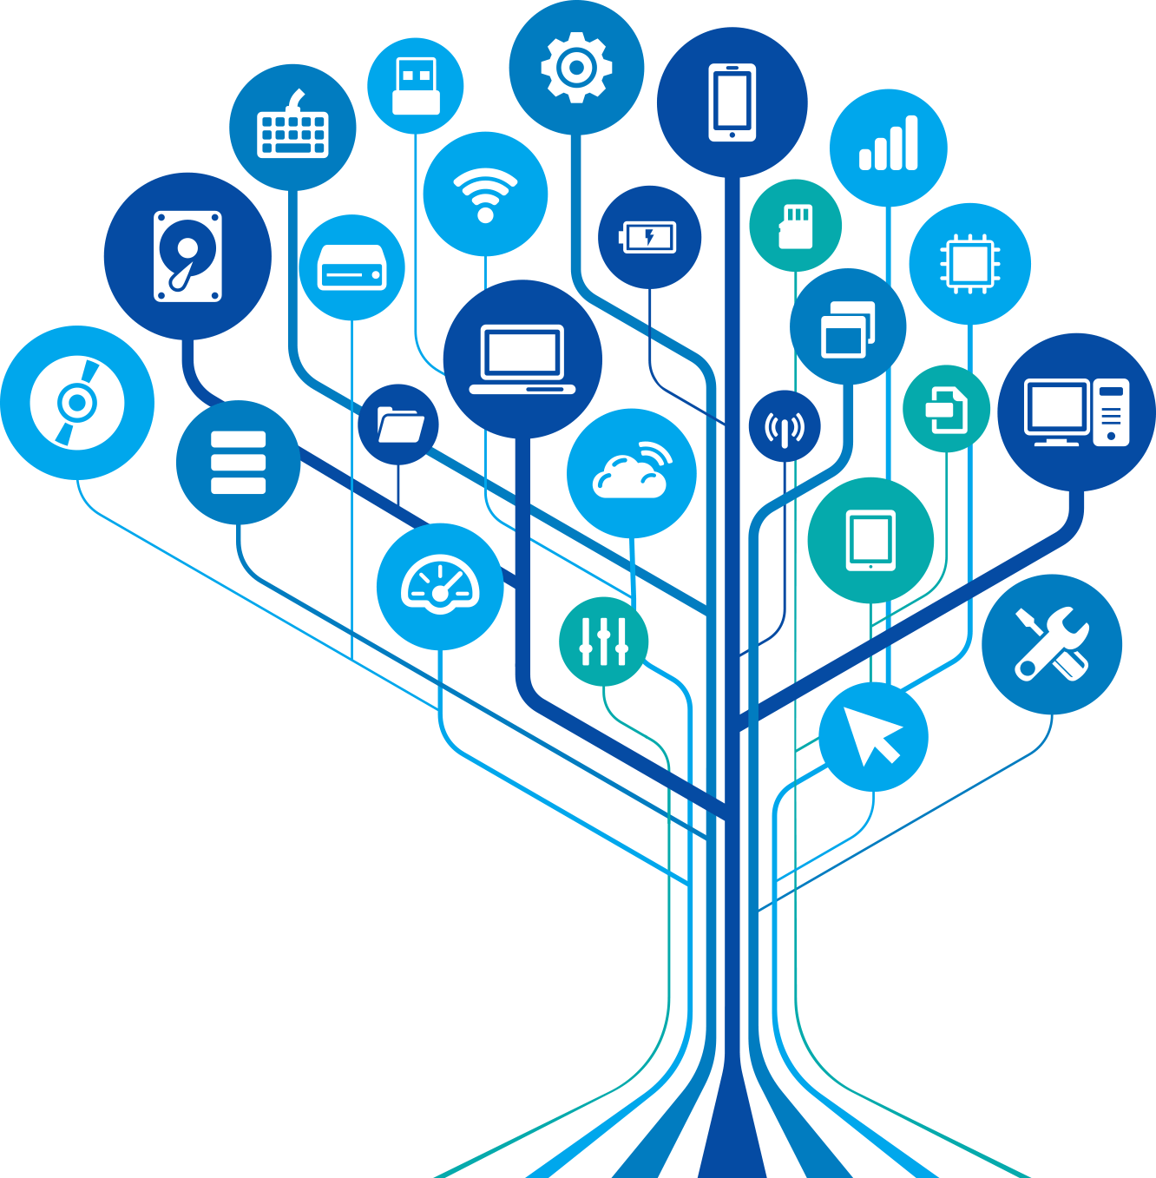
Internet of Things
IDC predict that spending on IoT will reach nearly $1.4 trillion in 2021. This coincides with companies continuing to invest in IoT hardware, software, services, and connectivity
Cisco estimates 50 B devices are now connected to IoT
Dr. Janusz Bryzek, vice president of MEMS and Sensing Solutions at Fairchild Semiconductor, predicts there will be 45 trillion networked sensors 20 years from now. This will be driven by smart systems, including IoT, mobile and wearable market growth, digital health, context computing, and artificial intelligence (AI)
IOT

Slide 32
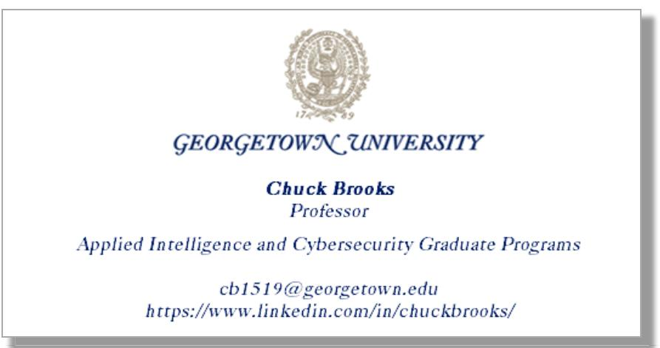

Slide 33
Thanks!
Any questions?
You can find me at:
Twitter: @ChuckDBrooks
Linkedin: Chuck Brooks

