Slide 1
{
Cyber Threat Intelligence: Understanding adversaries to banks in the-GCC and the importance of data sharing. Matt Suiche

Slide 2
Who am I?
Founder of Comae
Advisory Services
R&D
1M+ WannaCry infection prevented (variant #2)
OPCDE Technical Cybersecurity Conference
#2 Edition on April 6-7 2018
Enterprise Memory Forensics Platform
Porosity: Ethereum’s Smart Contract Decompiler

Slide 3
What’s Threat Intelligence?
Everyone seem to have their own definition of it…
Is it an Indicator of Compromise (IOC) threat feed product?
We personally define intelligence as:
Customer needs-focused capability
Not as a product.

Slide 4
Adversaries
Lazarus Group or Equation Group…
ETERNALBLUE / DOUBLEPULSAR / ETERNALROMANCE
Kernel Remote Code Execution for the masses.
The challenges of outsourcing IT (totally or partially)
Makes resources control harder
How many machines or admin accounts do you have?
Attracting and retaining talent within your organization

Slide 5
Ransomwares
Everybody’s threat.
In 2017, they impacted personal computers to global large businesses.
Many didn’t have any backups.
Attribution?
Does not necessarily help to protect your company better.

Slide 6
Banks are big organizations
Lots of employees, data control flow is often a problem.
Insider jobs can be a problems…
Leaked databases…
How to ensure data permissions, confidentiality and integrity within large organizations?

Slide 7
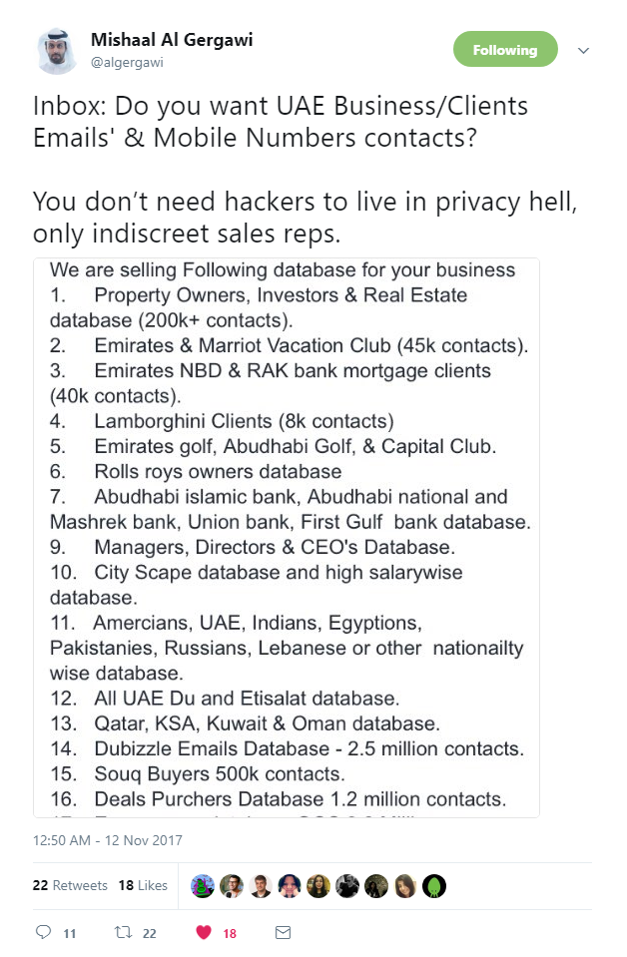

Slide 8
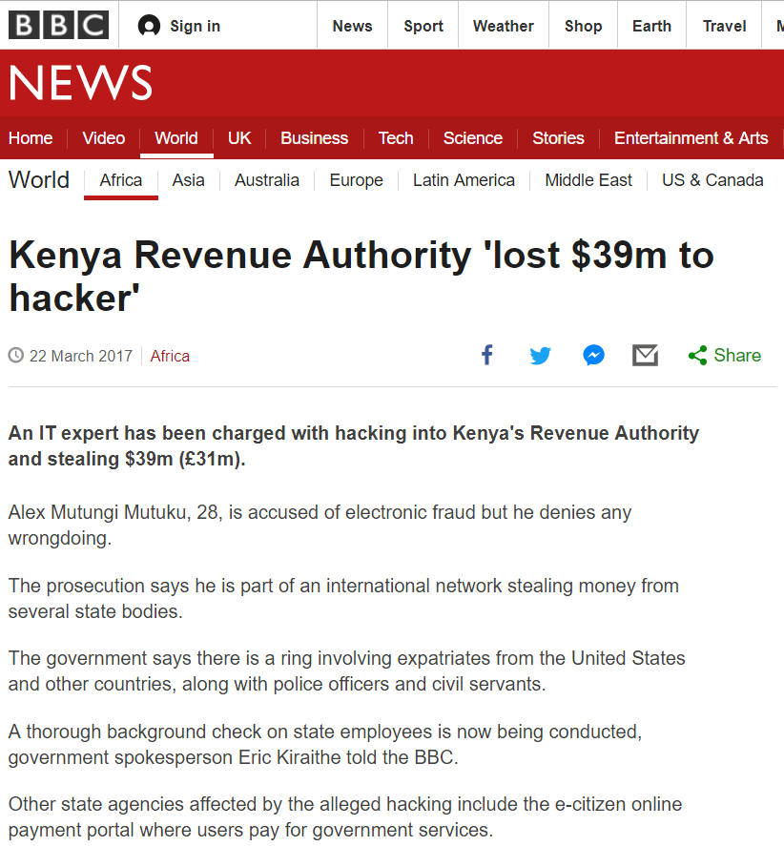

Slide 9
Does your organization has enough resources?
Active Directory security engineer
Incident Response Team
Big enough?
Recovery plan
Are you reachable in case of issues
secure@bank.ae ?
Is your management supporting your unit?
Budget and decisions
Culture
Not knowing everything is ok. Making mistakes too.

