Slide 1
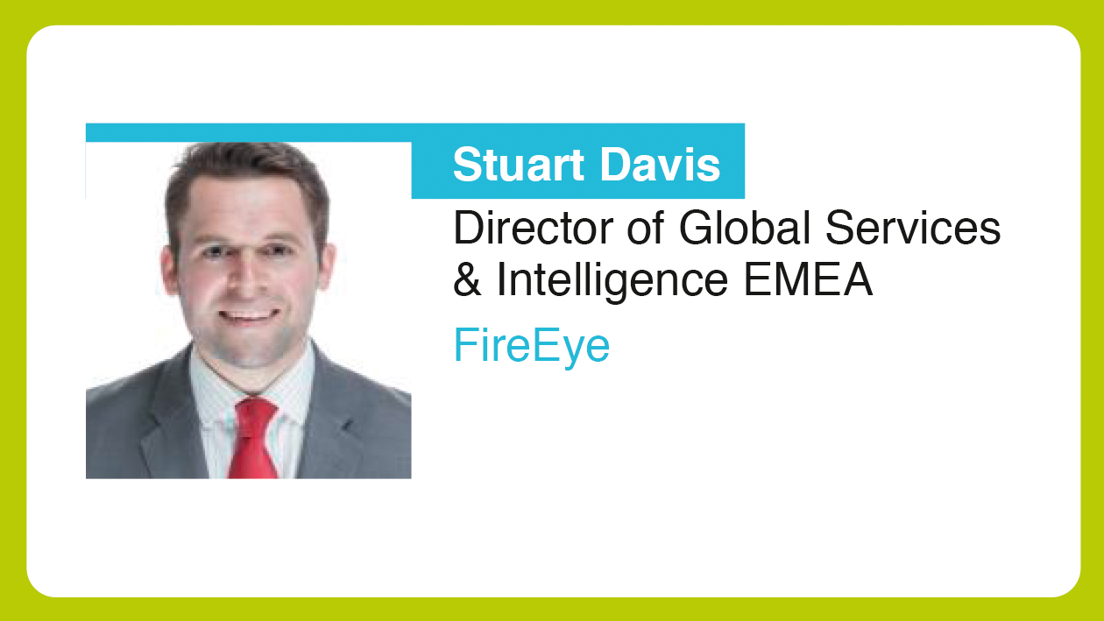

Slide 2
Detecting and Mitigating Threats: The Evolving Threat Landscape in the GCC
Presented by:
STUART DAVIS | Director, Global Services & Intelligence

Slide 3
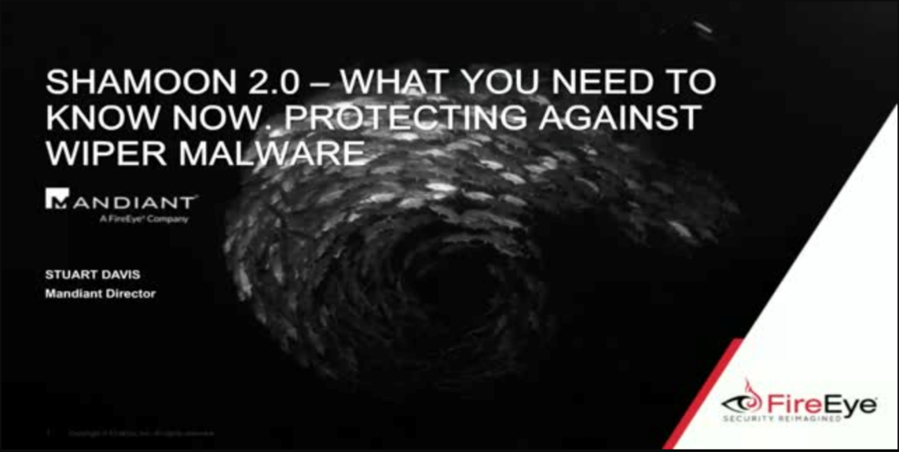
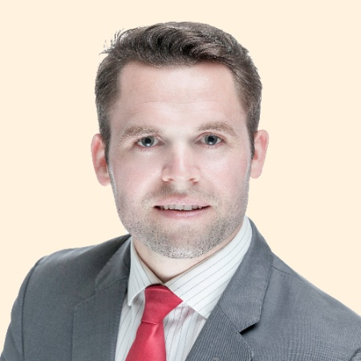
Intro
Who I am:
Stuart Davis
Director, Global Services & Intelligence Europe, Middle East & Africa
Previously, Consulting Services Manager, McAfee
https://www.linkedin.com/in/2stuartdavis/
Notes:
[Stuart to give his intro]
Before we introduce APT33, allow us to introduce ourselves.
<Stuart feel free to add any more slide content)

Slide 4
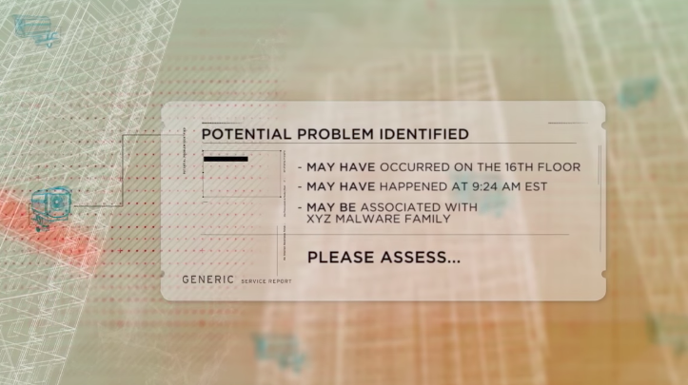
What problem do we have today?
Detect Something
Alert You
Ask you to check it
https://blogs.mulesoft.com/dev/api-dev/webinar-api-strategy/

Slide 5
What problem do we have today?
Detect Something
Alert You
Ask you to check it
We need to triage
We need context

Slide 6
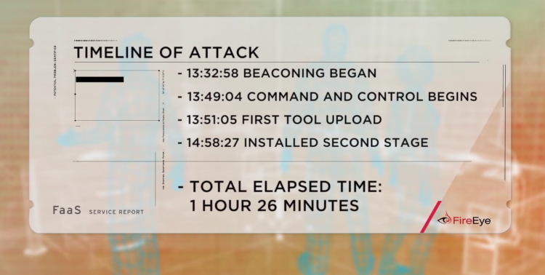
What problem do we have today?
Detect Something
Alert You
Ask you to check it
We need to triage
We need context
We need to timeline

Slide 7
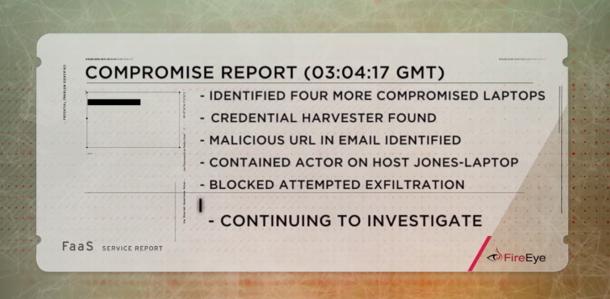
What problem do we have today?
Detect Something
Alert You
Ask you to check it
We need to triage
We need context
We need to timeline
We need to fully scope

Slide 8
Steps to APT Hunting
APT Hunting
Threat Intelligence Capability / Service
Incident Response
HUNTING
Network Forensics
Threat Intel / Data Analytics
Logs Analytics
RESPONSE
On-demand CIRT Services
Response Capability
Threat Detection & Response
Advanced Threat Protection
SIEM Monitoring
SIEM
DETECTION
NG Firewall
Incident Response Retainer
IDS/IPS
Firewall
Anti-Virus

Slide 9
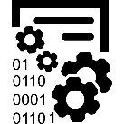
Sample SOC reference architecture
Firewall
Ticketing
Data Store
Big Data Analytics
IDS/IPS
Case Mgt.
SIEM
Malware/AV
Asset Mgt.
Endpoint
10 1001 01010 1010 1111 0010 0101
NetFlow
01 0110 0001 1110 1010 0101 0111 1
NW Gateways
L4 Proactive
Hunt Team
L2/3 SOC Analyst /
Incident Responder
L1 SOC Analyst
Orchestration & Threat Intelligence

