Slide 1
Threat landscape financial sector
UBF, Dubai, December 2017
REST ASSURED
www.csis.dk

Slide 2
Threat landscape financial sector
Agenda
1.00 Trends - Targeting the bank customers
2.00 Trends - Targeting the banks
3.00 Summary

Slide 3
Threat landscape financial sector
1.00
Trends - Targeting the bank customers

Slide 4
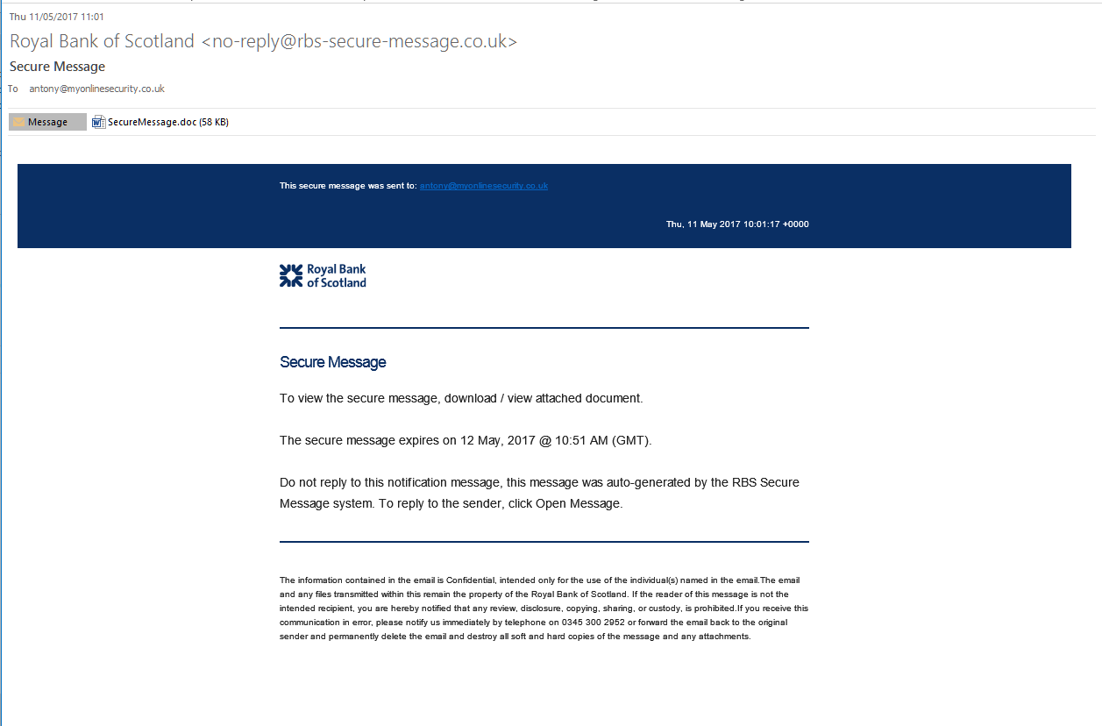
Sophisticated malware attack
Distributing malware such as Trickbot

Slide 5
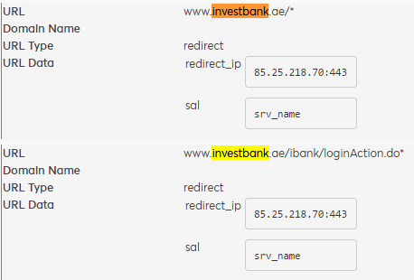
Sophisticated malware attack
Malware configuration file for Trickbot includes dedicated targets

Slide 6
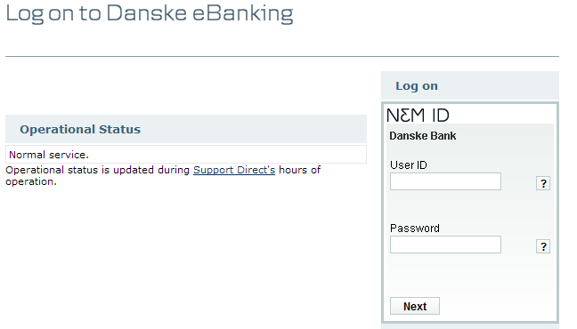
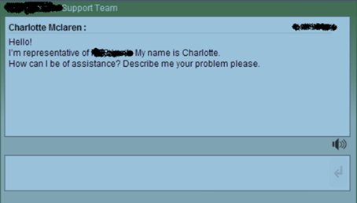
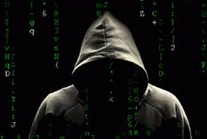
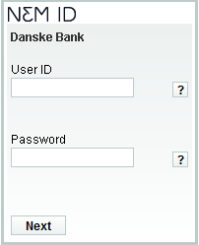
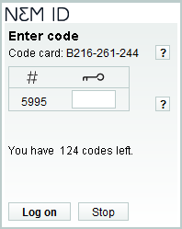
Sophisticated malware attack
Example on how Trickbot is able to circumvent two-factor authentication
08080808
1234
*******
08080808
*******

Slide 7
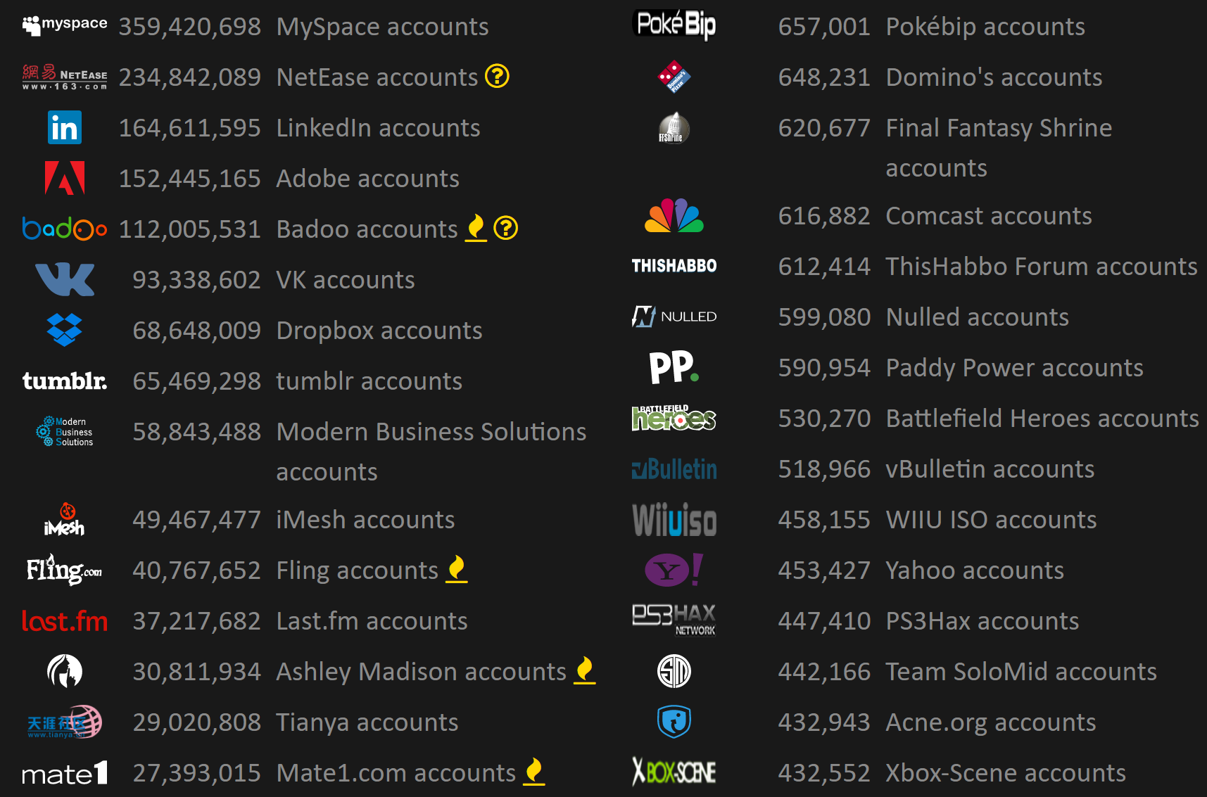
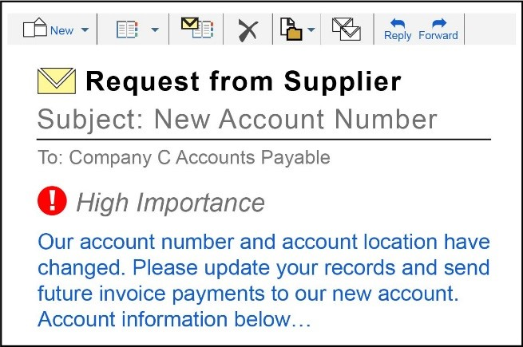
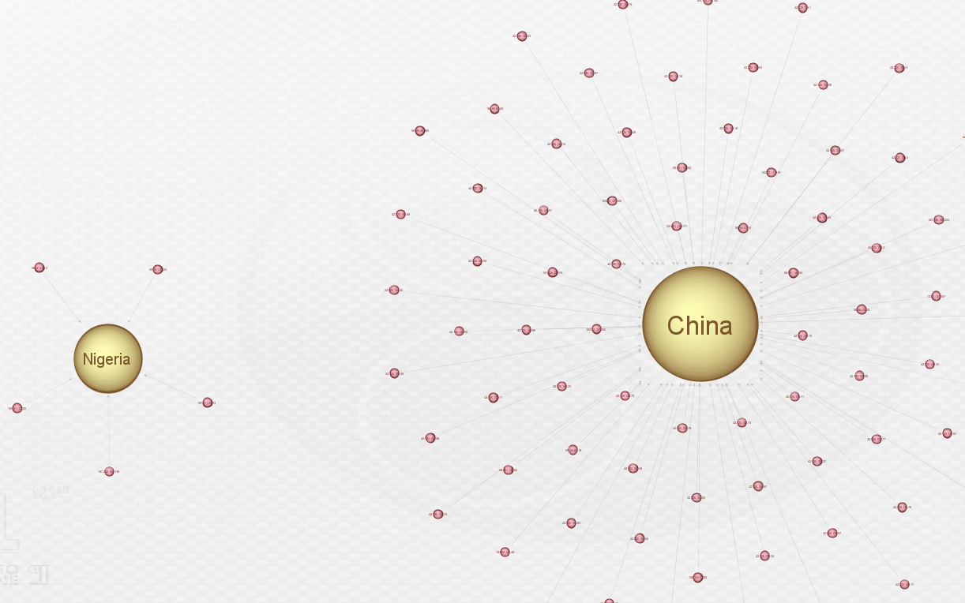
CEO and supplier/vendor fraud
Either compromising mail systems or using typo squatting domains

Slide 8
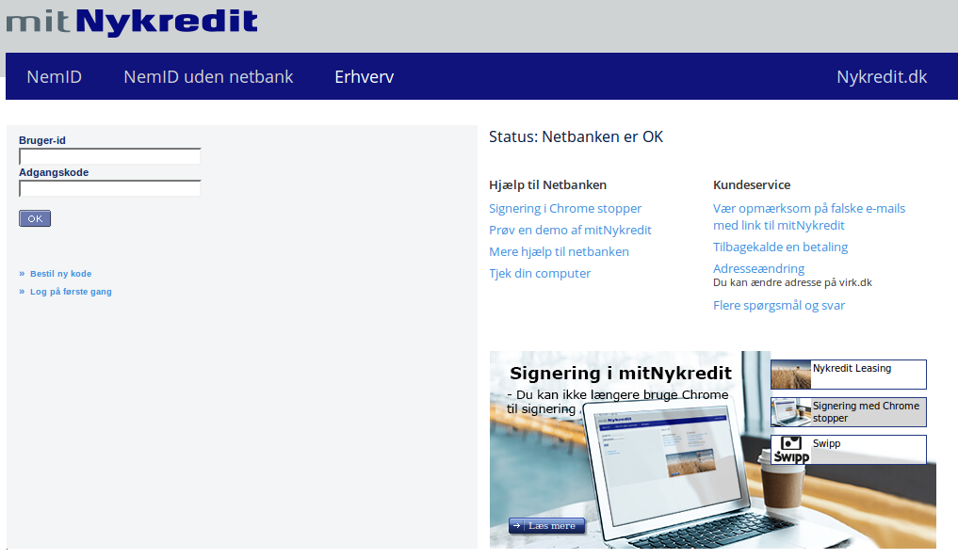
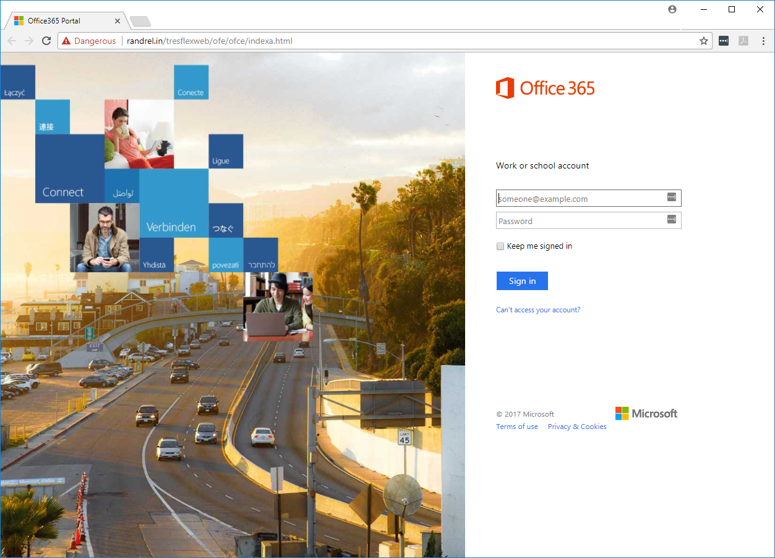
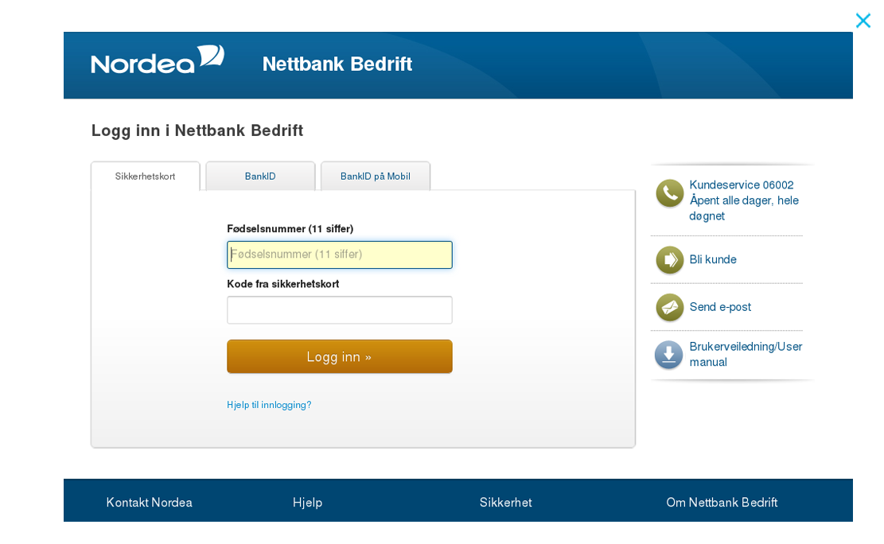
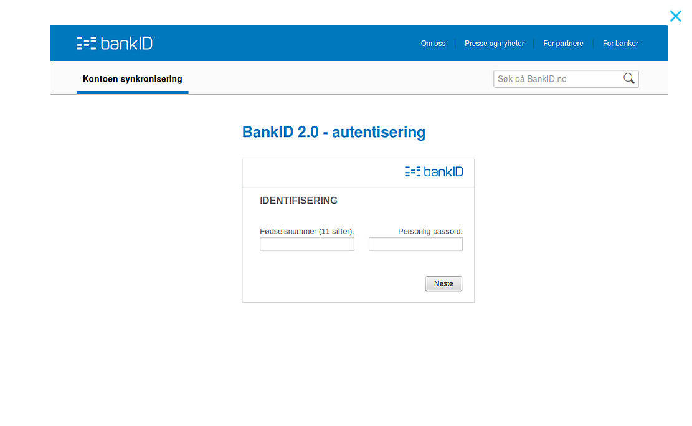
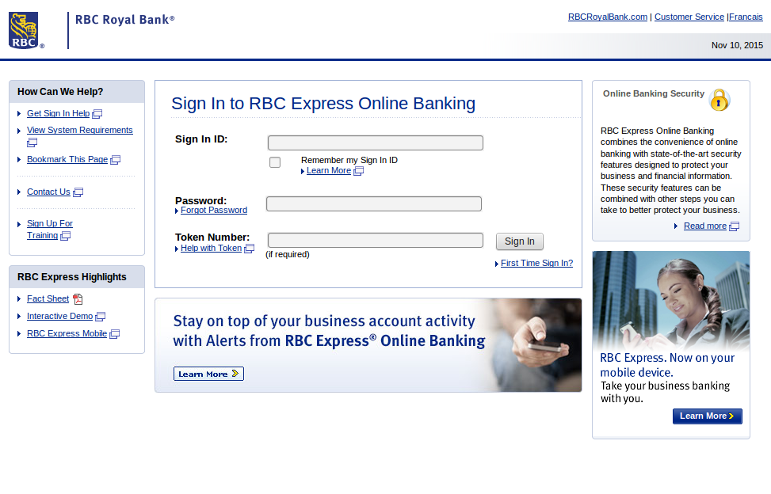
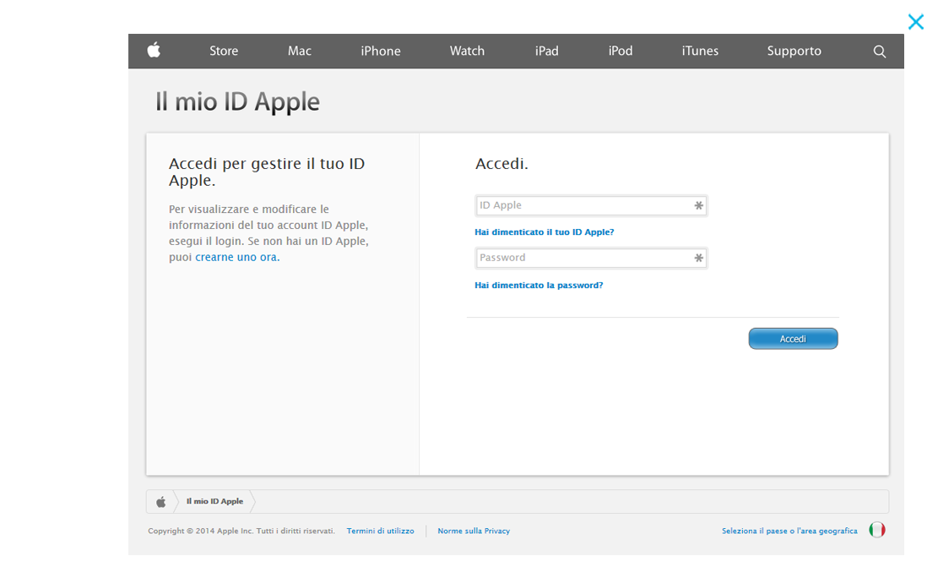
Smaller, more targeted phishing campaigns
Try to phish both credit cards and/or login credentials

Slide 9
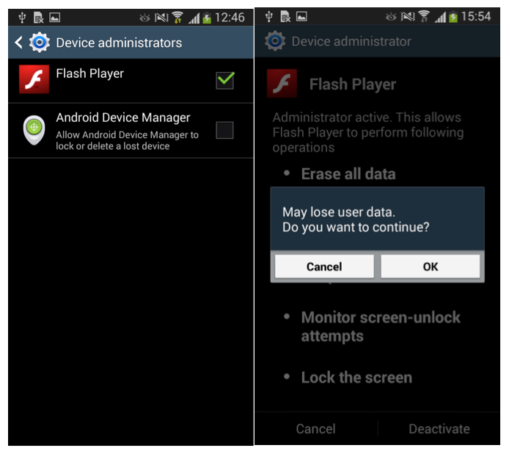
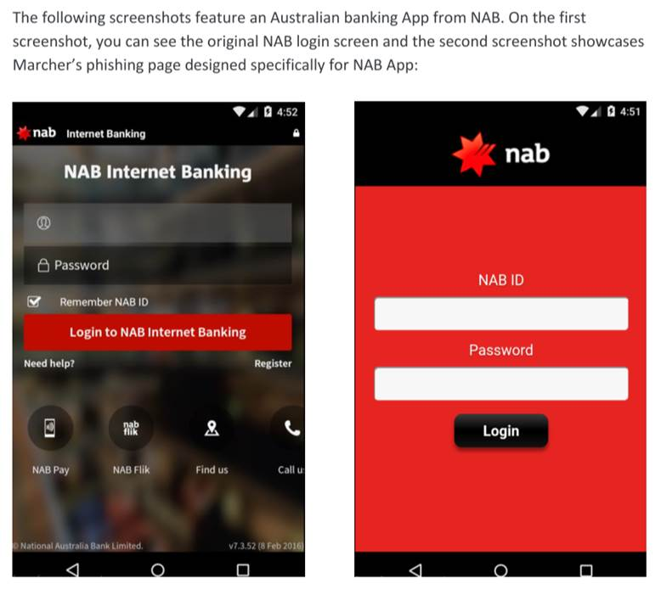
Mobile malware primarily targeting Android
Most mobile malware is only advanced phishing attacks (overlay attacks)

Slide 10
Threat landscape financial sector
2.00
Trends - Targeting the banks

Slide 11
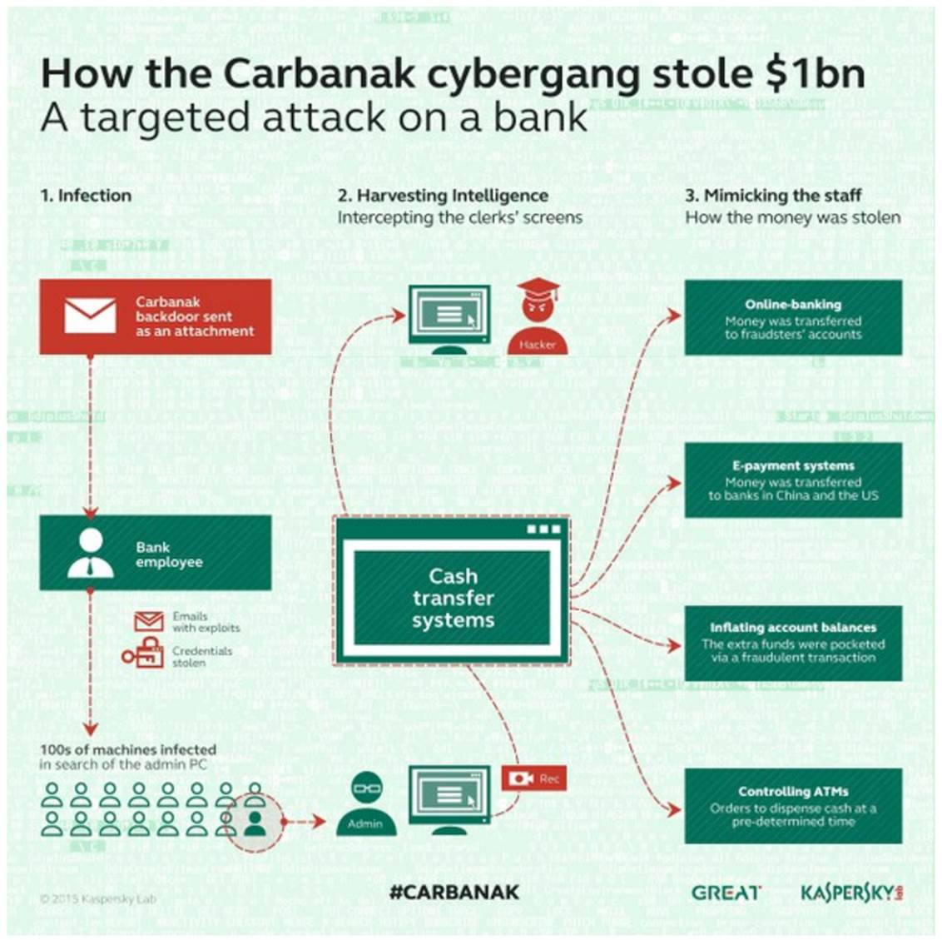
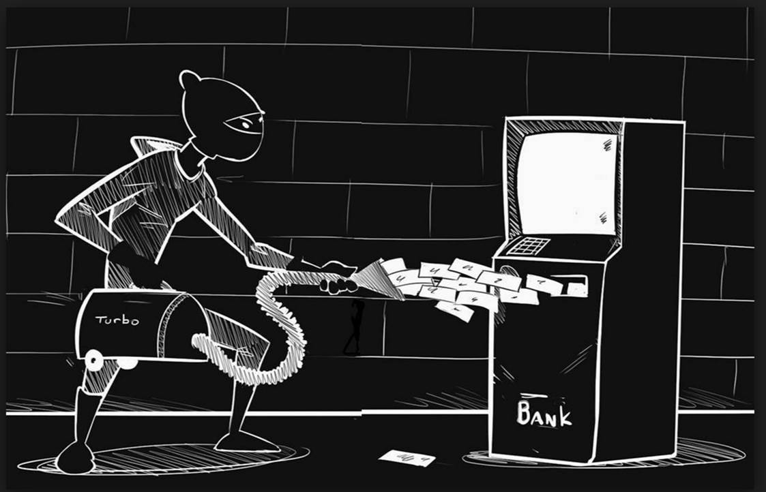
Threat actors becoming more patient, more professional
Carbanak case

Slide 12
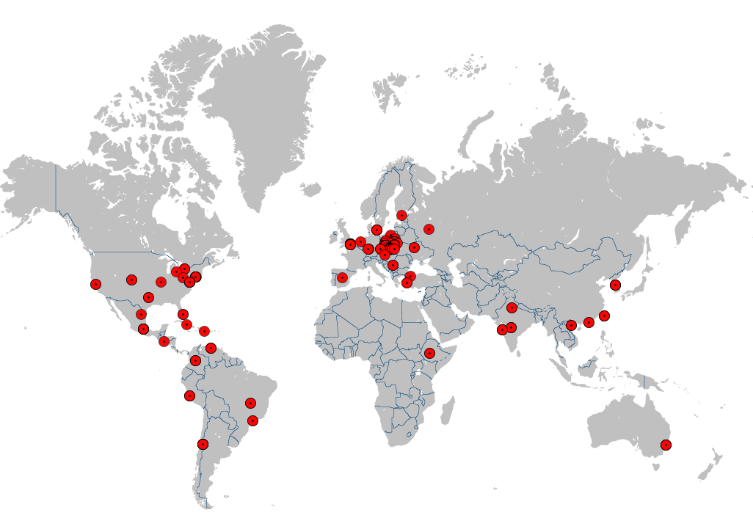
Threat actors becoming more patient, more professional
Polish waterhole attack
Poland hardest hit

Slide 13
Threat actors becoming more patient, more professional
Polish waterhole attack: someone seems to setup Russia to be behind the attack
Word | State/Backdoor Command
"Nachalo" | start communication session
"ustanavlivat" | handshake state
"poluchit" | receive data
"pereslat" | send data
"derzhat" | maintain communication session
"vykhodit" | exit communication session
Word | Type of error | Correct analogue
"ustanavlivat" | omitted sign at the end, verb tense error | "ustanovit'" or "ustanoviti"
"poluchit" | omitted sign at the end | "poluchit'" or "poluchiti"
"pereslat" | omitted sign at the end | "pereslat'" or "pereslati"
"derzhat" | omitted sign at the end | "derzhat'" or "derzhati"
"vykhodit" | omitted sign at the end, verb tense error | "vyiti"

Slide 14
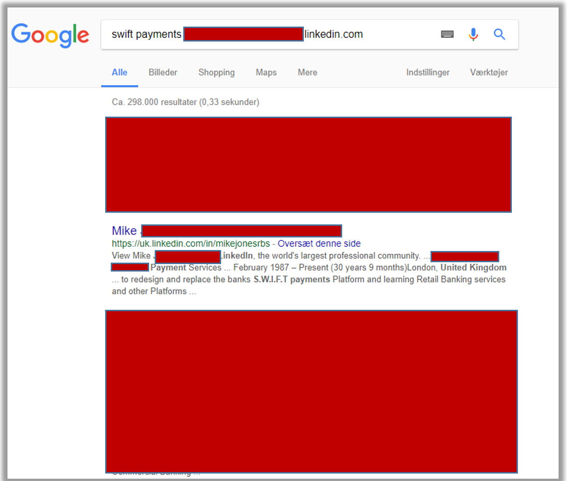
Threat actors becoming more patient, more professional
Taiwan Swift attack

Slide 15
Threat landscape financial sector
3.00
Summary

Slide 16
Summary
Important things to keep in mind for 2018
DDoS attacks expected to increase
RaaS expanding and evolving
Threat actors becoming more patient, more professional
Phishing campaigns smaller and more targeted
More ressources required by both organisations and vendors
More sophisticated attacks as CaaS models reach maturity

Slide 17
News
From today

Slide 18
Thank you!
Jakob Fonsbøl <jsf@csis.dk>
REST ASSURED
CSIS at glance:
Danish private security company founded in 2003
Advisory Board member of EC3 since 2013
100+ Employees from 25 different nationalities
Data centers located across the globe
150+ financial institutions
Advisors to law enforcement agencies
Copenhagen Cybercrime Conference hosts
Credited by Gartner Group
Actionable and renowned threat intelligence
Known for outstanding reversing, incident response and forensics capabilities
24/7 center with access to specialists
www.csis.dk

