Slide 1
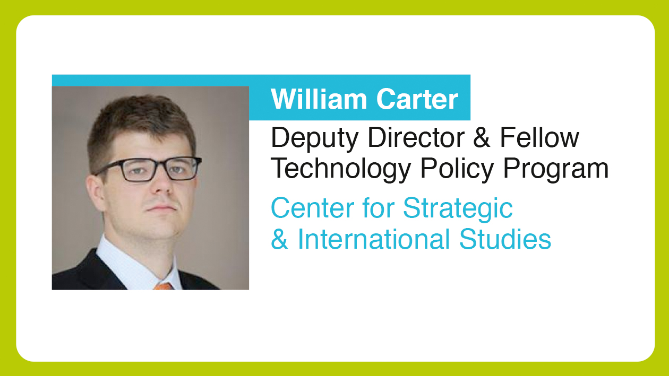

Slide 2
Cyber Risk in the Financial Sector
William A. Carter
Deputy Director, Technology Policy Program
Center for Strategic and International Studies

Slide 3
1. Attack Surface
2. Attacker Incentives
3. New Defenses
Mobile banking
Internet of Things
Changing geography of cyberspace
“Nation-states are robbing banks.”
Criminal groups more sophisticated, organized
Law enforcement capacity
DDoS Mitigation
Cyber hygiene training
Behavioral analytics
Multi-factor authentication

Slide 4
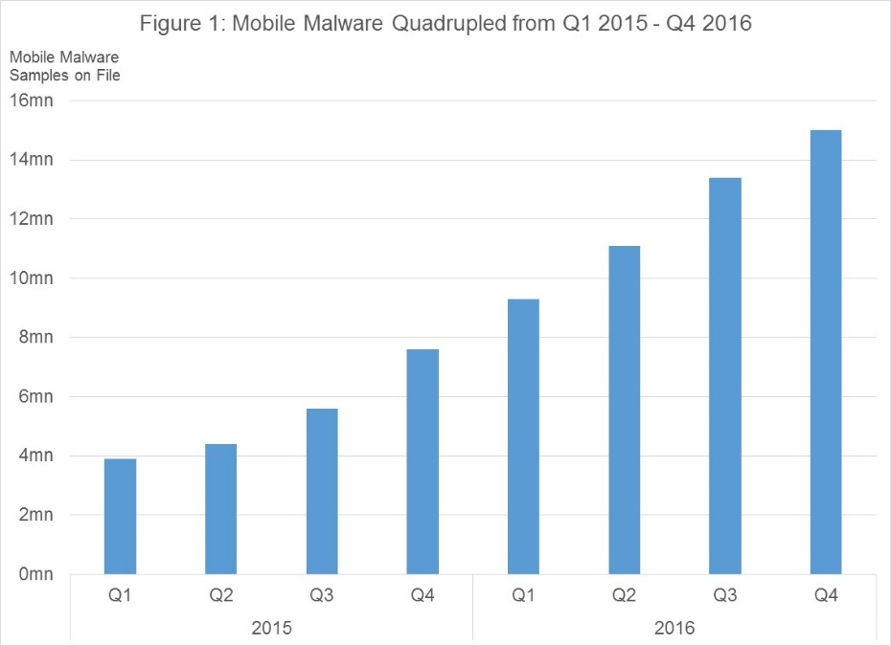
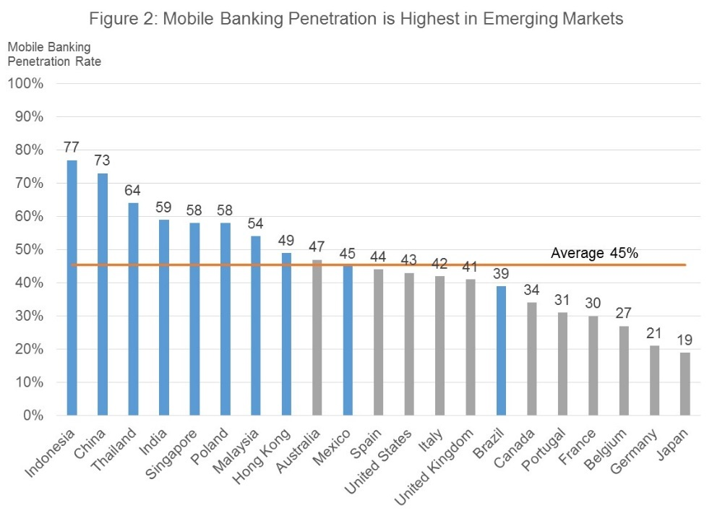

Slide 5
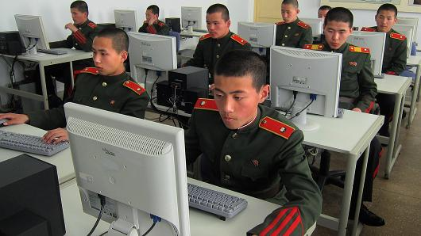

Slide 7
“Why should I bother to launch the attack myself? I can use a bot to search Project Unicorn or Shodan [search engines that allow cybercriminals to search for exploitable systems] for banks that use Apache Struts, which is widely used by banks and contains a lot of known vulnerabilities, and then drop off-the-shelf ransomware that exploits those vulnerabilities. These kinds of low-level attacks are easy to automate, then you can attack thousands of targets for cheap.”

Slide 9
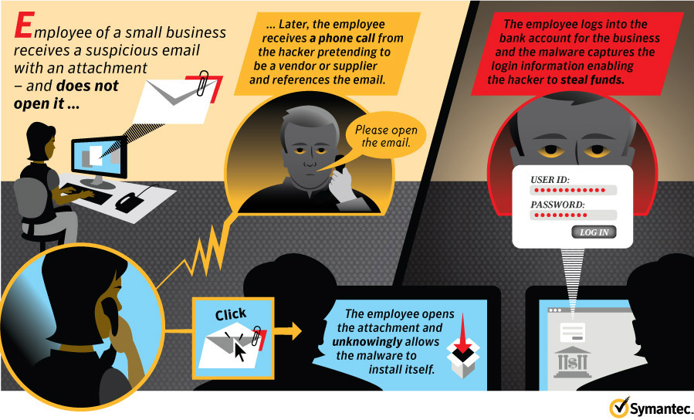

Slide 10
Questions

